Slide 1

Road accidents
T143 –Kushagra Singh

Slide 2
Major Issues
Issue 1-Distracted driving,drowsy driver,Night driving,minor driving
Issue 2-Skipping signals,overtaking from wrong side,Tailgating
Issue 3-Deadly curves,not remaining cautious in accident prone zone,potholes

Slide 3
Solutions for First Issue
Installing cameras on the dashboards, primarily for cabs,rental services like autos,transport vehicles which tend to be excessively on roads.
The cameras involving a ML based backend should identify whether the person is blinking the eyes too often,or is closing the eyes for way long while driving indicating a drowsy driver,or cases such as the driver is distracted when simultaneously using phone or eating .
An alarm should be triggered inside the car asking to pull the car over and freshen up or stop using devices while driving.If the driver fails to fulfill the condition a message should pop up with the drvier contacts at the road safety terminals and then either the driver is called and instructed to stop the car or a penalty is imposed.
Above the webcam there should be a scanner of QR code which should be embedded in the driving licence.The ought to scan the QR code prior to commencing the ride.This would drastically reduce chances of minors driving or a person not having valid driving license driving a car.

Slide 4
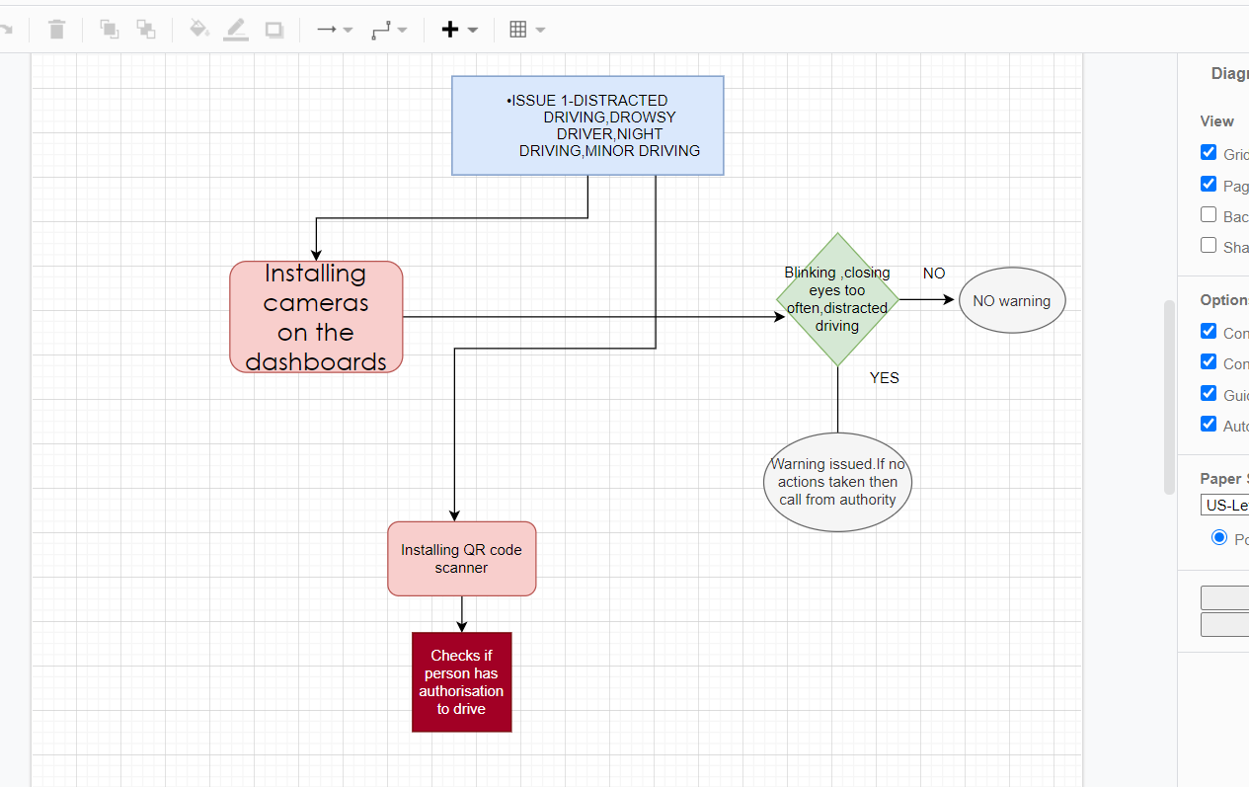
DRAWIO REPRESENTATION

Slide 5
Ways to resolve the second Issue
Atleast 3-4 small cameras and sensors should be put on the exterior of the car.
There should be a ML based chips which should be mandatory to be installed inside the car while manufacturing and in not so proximity such that it can be easily altered by a person.
The chip should initiate a waring when the car is crossing the speed limit which is set for that region or is not driving on the wrong side of the lane(all the data and stats related to speed limits should be standardized and stored in the memory).
The cameras and sensors can keep a check if the driver is overtaking from the right side or not.
The chip also should contain a gps tracker to help the cops track the person with the vehicles in case one is involved in any kind of malpractices.
If the driver is often tailgating other vehicles than the sensors can spot that.
Web cabs having ML backed should be installed on the traffic lights and if any driver is skipping it then using wifi the chip installed in the cars should be triggered and the exact location and number plate is updated at the road safety teminal

Slide 6
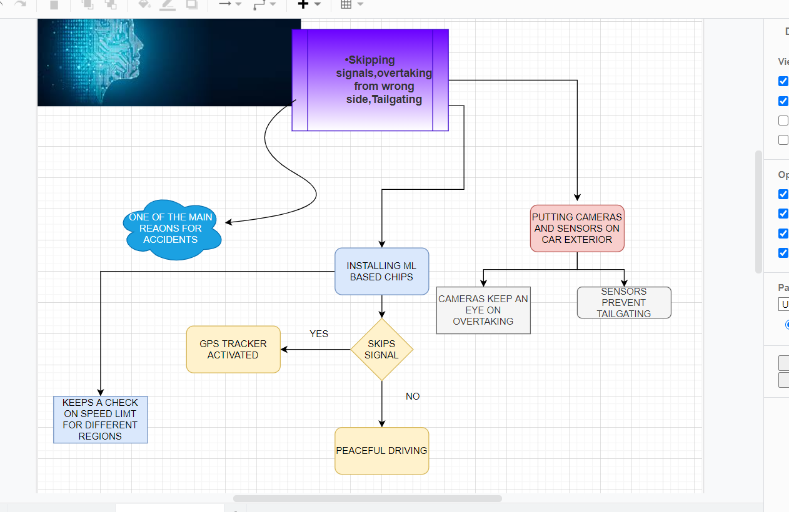
DRAWIO REPRESENTATION-

Slide 7
Sorting out the third issue-
A Artificial Intelligence based systems should be present in the car which is conneted to the chip installed or the driver has an option to use the Mobile Bluetooth .
There should be a voice message to the driver of being cautious when he is entering a zone frequently prone to accidents.
Driver should be informed if there is a dead end or a deadly curve ahead.
When on a difficult terrain such as mountainsor steep slope,using the satellite imaging the driver should be informed if there is a car approaching from the another direction.
The cameras installed on the exterior of the cars should also keep a check on the condition of the roads.If there are too many pot holes then a messase should be sent to the concerned authorities required immediate actions to improve the condition of the road.
If the required department doesn’t take action under stipulated time period.Then higher authorities should be informed using AI in the background at the earliest.

Slide 8
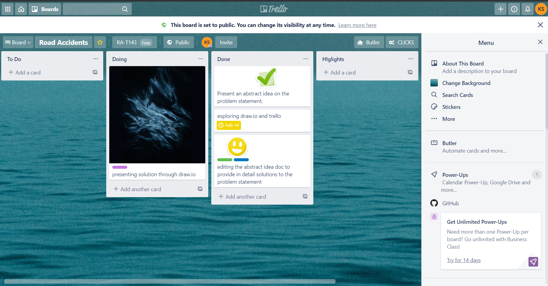
TRELLO

Slide 9
LINK FOR TRELLO
https://trello.com/b/gDWrr8ZH/road-accidents

